Slide 1



Changes in cellular survival in response to stress during the evolution of multicellularity
Priscilla Cortez
Mentors: Dinah Davison and Dr. Rick Michod
University of Arizona
Notes:
Change to my images

Slide 2
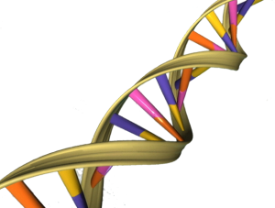
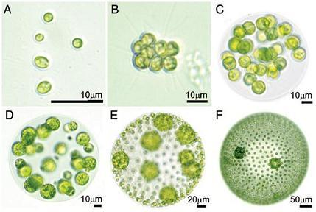
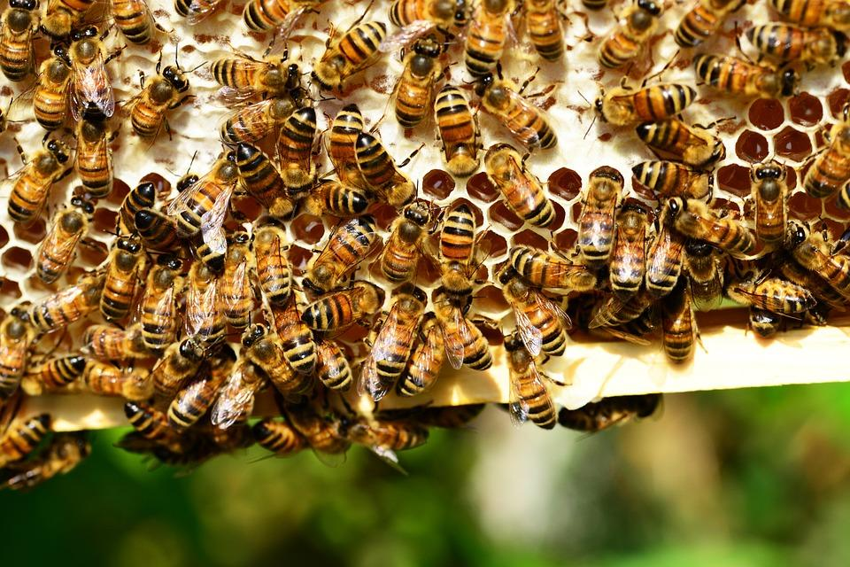
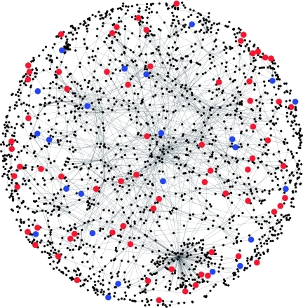
Evolutionary individuals: the unit of selection
© East London Genes and Health
© Framepool
© ASU 2017
© Lu et al. 2007 Mol. Syst. Biol.
Modified from Michod 2007 PNAS
Notes:
All disciplines define their basic units and core processes. In evolution, the unit of selection is that of the evolutionary individual. Evolutionary individuals include genes, networks of genes, unicellular organisms which come together to form multicellular organisms which can come together to form eusocial societies. This forms the hierarchy of life.
Groups of cells (simple multicellular organism)

Slide 3
Evolutionary transitions in individuality
Groups of individuals become new kinds of individuals
  Fitness reorganized
Evolution of multicellularity
Model system: volvocine green algae
Individuality may be present at multiple hierarchical levels
  Selection can act at the cell level and multicellular organism level
  Causes variation in individuality
Chlamydomonas
Gonium
Platydorina
Volvox
Notes:
During a transition in individuality such as the evolution of multicellularity, lower-level units cooperate and form a new, group-level individual.
A range of mechanisms mediate transitions in individuality
Germ-soma division of labor
Genetic homogeneity
Genetic uniqueness
-selection can act a the cell level and group level
Use volvocine green algae to beter understand these levels
Include pics of each species

Slide 4
Research questions
What are the consequences of differences in individuality?
Do differences in individuality affect survival in response to stress?
Does being in a group increase the likelihood of any given cell surviving under stressful conditions?
Chlamydomonas
Gonium
Platydorina
Volvox
Notes:
Include pics here as well

Slide 5
Hypotheses
Null: Individuality does not play a role in how well a given species can survive and reproduce under a stressful condition.
H1: If individuality differences affect survival, then species who demonstrate a higher level of individuality will have a higher survival rate
H2: If individuality differences affect survival, then the simpler species will have a higher survival rate
S
Notes:
H1: the somatic cells in a species like Volvox are devoted to survival while the germ cells are able to focus on reproducing, vs. an undifferentiated or unicellular species who might not be able to reproduce because it must prioritize survival and it is unable to efficiently perform both tasks at once
H2: Unspecialized species also have simpler components where there is less to go wrong

Slide 6
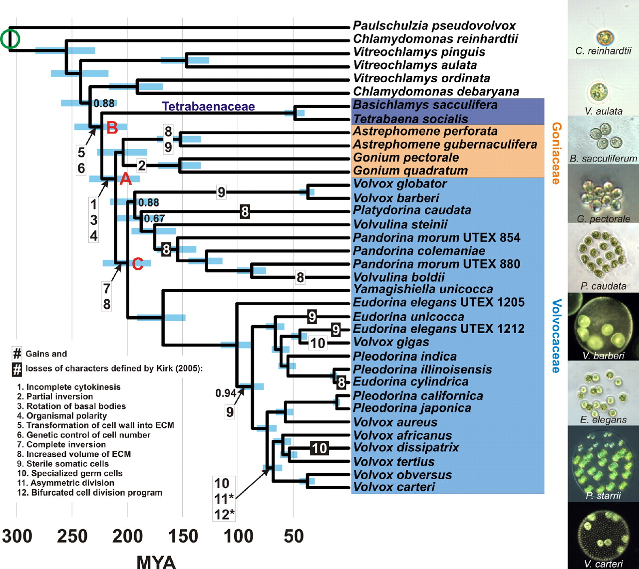
Methods: species
Four species
  Chlamydomonas reinhardtii (unicellular)
  Gonium pectorale (undifferentiated/unicellular)
  Platydorina caudata (undifferentiated)
  Volvox ferrisii (germ-soma differentiated)
Differences in individuality
Chlamydomonas
Gonium
Platydorina
Volvox
© Herron et al. 2009 PNAS
©2013, Nozaki and Coleman
Notes:
Gonium; in stressful enviroments they will come apart and form unicellular lineages
-typically characterized being multicellular in good conditions
-do not experience germ-soma specialization, it is just a cluster of undifferentiated cells
Platy: always multicellular

Slide 7
Methods: experimental setup
Standard laboratory conditions (SVM)
  Chlamydomonas: N = 272
  Gonium: N = 303
  Platydorina: N = 212
  Volvox: N = 63
Nitrogen deprivation
  Chlamydomonas: N = 194
  Gonium: N = 193
  Platydorina: N = 126
  Volvox: N = 57
Set-up well plates
Allowed colonies to reproduce for three generations

Slide 8
Methods cont.
Stained colonies with vital stain trypan blue
  Permeates dead cells and stains them blue
  Living cells remain green
Imaged colonies with Nikon Eclipse TI
Analyzed data
  Chi-squared test
Notes:
INCLUDE microscope pic

Slide 9
Results: Chlamydomonas reinhardtii
 | Alive | Dead | Total Colonies
Standard volvox media | 272 | 0 | 272
Nitrogen deprivation | 189 | 5 | 194
Fisher’s exact probability test (two-tailed):
P-value = 0.0121
Alive
Dead
Notes:
Chi-squared is calculated only if all expected cell frequencies are equal to or greater than 5

Slide 10
Results: Gonium pectorale
 | Alive | Dead | Total Colonies
Standard volvox media | 302 | 1 | 303
Nitrogen deprivation | 182 | 11 | 193
Fisher’s exact probability test (two-tailed):
P-value = 0.0002
Alive
Dead

Slide 11
Results: Platydorina caudata
 | Alive | Dead | Total Colonies
Standard volvox media | 195 | 17 | 212
Nitrogen deprivation | 45 | 81 | 126
Fisher’s exact probability test (two-tailed):
P-value < 0.0001
Alive
Dead

Slide 12
Results: Volvox ferrisii
 | Alive | Dead | Total Colonies
Standard volvox media | 29 | 34 | 63
Nitrogen deprivation | 18 | 39 | 57
Fisher’s exact probability test (two-tailed):
P-value = 0.1346
Alive
Dead

Slide 13
Results
SVM
N-
Chlamydomonas
Gonium
Platydorina
Volvox

Slide 14
Conclusions
There is a higher proportion of live colonies in N- for Chlamydomonas and Gonium
  This shows that Gonium’s tactic to become unicellular when placed under stress may increase cell survival
This indicates there are cell-level survival costs associated with being multicellular
Every species, except for volvox, showed differences in cell survival in response to stress
  The proportion of alive versus dead colonies is significantly different among the two treatments
  High rate of death in volvox colonies for both treatments may be due to their large size in relation to the wells
    Deficiency in nutrients?
Additional analysis needed
Notes:
Reproduction rate? The fact that there were less colonies under stress than in control?

Slide 15
Acknowledgements
Dr. Rick Michod
Michod Lab
  Dinah Davison
  Zach Grochau-Wright
Arizona Space Grant

Slide 16
The end…
Thank you!

Slide 17
Evolutionary transitions in individuality
Groups of individuals become new kinds of individuals
  Fitness reorganized
(i) Groups formed
(ii) Cooperation among cells
(iii) Cheating → conflict among cells
(iv) Conflict mediation → increased cooperation
(v) Division of labor
(vi) Selection acts at the group level
Reviewed in Hanschen*, Davison* et al. 2017
Modified from Michod 2007 PNAS
Notes:
During a transition in individuality such as the evolution of multicellularity, lower-level units cooperate and form a new, group-level individual.
A range of mechanisms mediate transitions in individuality
Germ-soma division of labor
Genetic homogeneity
Genetic uniqueness

Slide 18
Individuality criteria
Numerous criteria for delineating individuality
  Genetic uniqueness
  Genetic homogeneity
  Division of labor
  Indivisibility
  Physiological unity and integration
  Spatial/temporal boundaries
  Group-level adaptations
  Multilevel selection 2
Species can fulfill different combinations of criteria
Different kinds of evolutionary individuals may exist
Reviewed in Hanschen*, Davison* et al. 2017
Modified from Michod 2007 PNAS
Notes:
During a transition in individuality such as the evolution of multicellularity, lower-level units cooperate and form a new, group-level individual.
A range of mechanisms mediate transitions in individuality
Germ-soma division of labor
Genetic homogeneity
Genetic uniqueness

Slide 19
Volvocine algae ecology
Found in freshwater lakes and ponds
Global distribution
Require nutrients such as nitrogen and phosphate
Notes:
Insert image of lake here (reid park)

